Slide 1

SLIDES . BY
.
.
.
.
.
.
.
.
.
.
.
Yaochen Kuo
KAINAN
University

Slide 2
Chapter 6
Continuous Probability Distributions
Uniform Probability Distribution
Normal Probability Distribution
Normal Approximation of Binomial Probabilities
Exponential Probability Distribution
f (x)
Exponential
Uniform
f (x)
Normal
f (x)
x
x
x

Slide 3
Continuous Probability Distributions
A continuous random variable can assume any value in an interval on the real line or in a collection of intervals.
It is not possible to talk about the probability of the random variable assuming a particular value.
Instead, we talk about the probability of the random variable assuming a value within a given interval.

Slide 4
Continuous Probability Distributions
The probability of the random variable assuming a value within some given interval from x₁ to x₂ is defined to be the area under the graph of the probability density function between x₁ and x₂.
f (x)
Exponential
Uniform
f (x)
Normal
f (x)
x₁
x₂
x
x
x₁
x₂
x₁
x₂
x
x₁
x₂

Slide 5
Uniform Probability Distribution
A random variable is uniformly distributed whenever the probability is proportional to the interval’s length.
The uniform probability density function is:
f (x) = 1/(b – a) for a < x < b
= 0 elsewhere
where: a = smallest value the variable can assume
b = largest value the variable can assume

Slide 6
Uniform Probability Distribution
Expected Value of x
E(x) = (a + b)/2
Variance of x
Var(x) = (b - a)²/12

Slide 7
Uniform Probability Distribution
Example: The flight time of an airplane
Consider the random variable x representing the flight time of an airplane traveling from Chicago to New York. Suppose the flight time can be any value in the interval from 120 minutes to 140 minutes. Let’s assume that sufficient actual flight data are available to conclude that the probability of a flight time within any 1-minute interval is the same as the probability of a flight time within any other 1-minute interval contained in the larger interval from 120 to 140 minutes.

Slide 8
Uniform Probability Distribution
Uniform Probability Density Function
f(x) = 1/20 for 120 < x < 140
= 0 elsewhere
where:
x = the flight time of an airplane traveling
from Chicago to New York

Slide 9
Uniform Probability Distribution
Expected Value of x
E(x) = (a + b)/2
= (120 + 140)/2
= 130
Variance of x
Var(x) = (b - a)²/12
= (140 – 120)²/12
= 33.33

Slide 10
Uniform Probability Distribution
Uniform Probability Distribution
for the flight time (Chicago to New York)
f(x)
1/20
x
0
120
130
140
Flight Time(minutes)

Slide 11
Uniform Probability Distribution
What is the probability that a airplane will take between 135 and 140 minutes from Chicago to New York?
f(x)
P(135 < x < 140) = 1/20(5) = .25
1/20
x
0
120
130
135
140
Flight Time(minutes)

Slide 12
Area as a Measure of Probability
The area under the graph of f(x) and probability are identical.
This is valid for all continuous random variables.
The probability that x takes on a value between some lower value x₁ and some higher value x₂ can be found by computing the area under the graph of f(x) over the interval from x₁ to x₂.

Slide 13
Normal Probability Distribution
The normal probability distribution is the most important distribution for describing a continuous random variable.
It is widely used in statistical inference.
It has been used in a wide variety of applications
including:
Heights of people
Rainfall amounts
Test scores
Scientific measurements

Slide 14
Normal Probability Distribution
Normal Probability Density Function
where:
μ = mean
σ = standard deviation
π = 3.14159
e = 2.71828

Slide 15
Normal Probability Distribution
Characteristics
The distribution is symmetric; its skewness
measure is zero.
x

Slide 16
Normal Probability Distribution
Characteristics
The entire family of normal probability
distributions is defined by its mean μ
and its standard deviation σ .
Standard Deviation σ
x
Mean μ

Slide 17
Normal Probability Distribution
Characteristics
The highest point on the normal curve is at the
mean, which is also the median and mode.
x

Slide 18
Normal Probability Distribution
Characteristics
The mean can be any numerical value: negative,
zero, or positive.
x
-10
0
25

Slide 19
Normal Probability Distribution
Characteristics
The standard deviation determines the width of the
curve: larger values result in wider, flatter curves.
σ = 15
σ = 25
x

Slide 20
Normal Probability Distribution
Characteristics
Probabilities for the normal random variable are
given by areas under the curve. The total area
under the curve is 1 (.5 to the left of the mean and
.5 to the right).
.5
.5
x

Slide 21
Normal Probability Distribution
Characteristics (basis for the empirical rule)
of values of a normal random variable
are within of its mean.
68.26%
+/- 1 standard deviation
of values of a normal random variable
are within of its mean.
95.44%
+/- 2 standard deviations
of values of a normal random variable
are within of its mean.
99.72%
+/- 3 standard deviations

Slide 22
Normal Probability Distribution
Characteristics (basis for the empirical rule)
99.72%
95.44%
68.26%
x
μ
μ – 3σ
μ – 1σ
μ + 1σ
μ + 3σ
μ – 2σ
μ + 2σ

Slide 23
Standard Normal Probability Distribution
Characteristics
A random variable having a normal distribution
with a mean of 0 and a standard deviation of 1 is
said to have a standard normal probability
distribution.

Slide 24
Standard Normal Probability Distribution
Characteristics
The letter z is used to designate the standard
normal random variable.
σ = 1
z
0

Slide 25
Standard Normal Probability Distribution
Converting to the Standard Normal Distribution
We can think of z as a measure of the number of
standard deviations x is from μ.

Slide 26
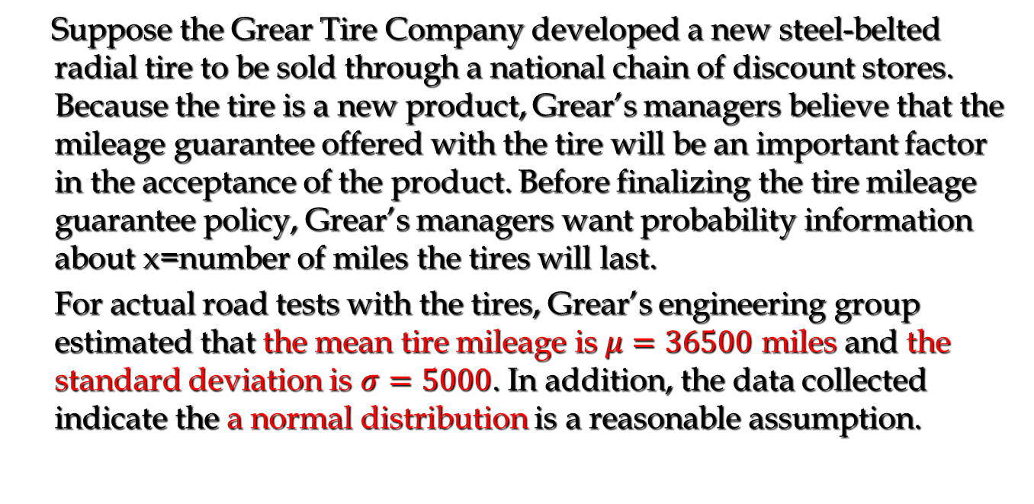
Standard Normal Probability Distribution
Example: Grear Tire Company
Suppose the Grear Tire Company developed a new steel-belted radial tire to be sold through a national chain of discount stores. Because the tire is a new product, Grear’s managers believe that the mileage guarantee offered with the tire will be an important factor in the acceptance of the product. Before finalizing the tire mileage guarantee policy, Grear’s managers want probability information about x=number of miles the tires will last.
For actual road tests with the tires, Grear’s engineering group estimated that the mean tire mileage is $μ=36500$ miles and the standard deviation is $σ=5000$. In addition, the data collected indicate the a normal distribution is a reasonable assumption.

Slide 27
Standard Normal Probability Distribution
Example: Grear Tire Company
What percentage of the tires can be expected to last more than 40000 miles?
P(x > 40000) = ?

Slide 28
Standard Normal Probability Distribution
Solving for the Stockout Probability
Step 1: Convert x to the standard normal distribution.
z = (x - μ)/σ
= (40000 - 36500)/5000
= .70
Step 2: Find the area under the standard normal
curve to the left of z = .70.
see next slide

Slide 29
Standard Normal Probability Distribution
Cumulative Probability Table for
the Standard Normal Distribution
P(z < .70)

Slide 30
Standard Normal Probability Distribution
Solving for the mileage Probability
Step 3: Compute the area under the standard normal
curve to the right of z = .70.
P(z > .70) = 1 – P(z < .70)
= 1- .7580
= .2420
Probability
of mileage >=40000
P(x > 40000)

Slide 31
Standard Normal Probability Distribution
Solving for the mileage Probability
Area = 1 - .7580
= .2420
Area = .7580
z
0
.70

Slide 32
Standard Normal Probability Distribution
Standard Normal Probability Distribution
Let us assume that Grear is considering a guarantee that will provide a discount on replacement tires if the original tires do not provide the guaranteed mileage. What should the guarantee mileage be if Grear wants no more than 10% of the tires to be eligible for the discount guarantee?

Slide 33
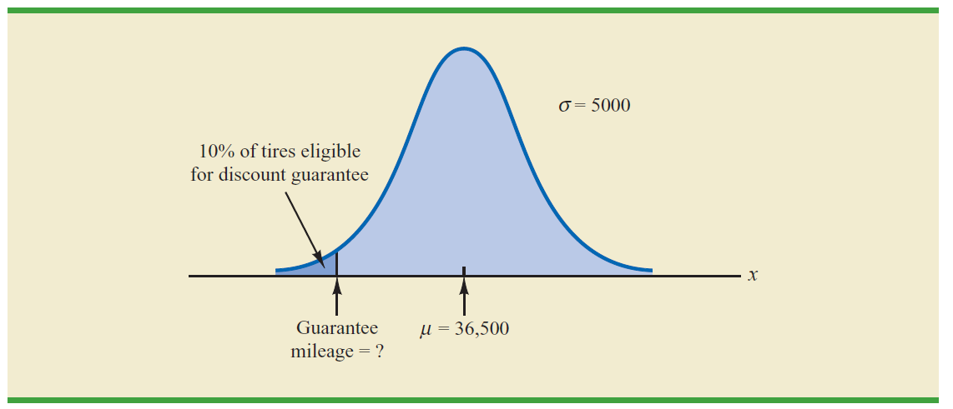
Standard Normal Probability Distribution
Solving for the guaranteed mileage

Slide 34
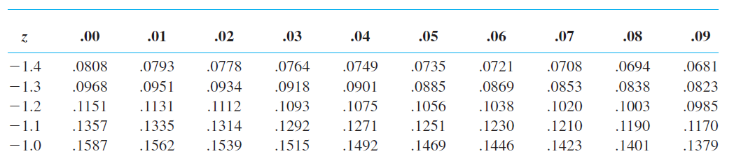
Standard Normal Probability Distribution
Step 1: Find the z-value that cuts off an area of .10
in the left tail of the standard normal
distribution.
We look up
the tail area =
.10

Slide 35
Standard Normal Probability Distribution
Solving the guaranteed mileage
Step 2: Convert z to the corresponding value of x.
x = μ + zσ
= 36500 - 1.28(5000)
= 30100
A guarantee of 30100 miles will meet the requirement
that approximately 10% of the tires will be eligible for
the guarantee.

Slide 36
Normal Approximation of Binomial Probabilities
When the number of trials, n, becomes large,
evaluating the binomial probability function by hand
or with a calculator is difficult.
The normal probability distribution provides an
easy-to-use approximation of binomial probabilities
where np > 5 and n(1 - p) > 5.
In the definition of the normal curve, set
❍ = np and

Slide 37
Normal Approximation of Binomial Probabilities
Add and subtract a continuity correction factor
because a continuous distribution is being used to
approximate a discrete distribution.
For example, P(x = 12) for the discrete binomial
probability distribution is approximated by
P(11.5 < x < 12.5) for the continuous normal
distribution.

Slide 38
Normal Approximation of Binomial Probabilities
Example
Suppose that a company has a history of making errors in 10% of its invoices. A sample of 100 invoices has been taken, and we want to compute the probability that 12 invoices contain errors.
In this case, we want to find the binomial probability of 12 successes in 100 trials. So, we set:
μ = np = 100(.1) = 10
= [100(.1)(.9)] ^{½} = 3

Slide 39
Normal Approximation of Binomial Probabilities
Normal Approximation to a Binomial Probability
Distribution with n = 100 and p = .1
σ = 3
P(11.5 < x < 12.5)
(Probability
of 12 Errors)
x
μ = 10
12.5
11.5

Slide 40
Normal Approximation of Binomial Probabilities
Normal Approximation to a Binomial Probability
Distribution with n = 100 and p = .1
P(x < 12.5) = .7967
x
10
12.5

Slide 41
Normal Approximation of Binomial Probabilities
Normal Approximation to a Binomial Probability
Distribution with n = 100 and p = .1
P(x < 11.5) = .6915
x
10
11.5

Slide 42
Normal Approximation of Binomial Probabilities
The Normal Approximation to the Probability
of 12 Successes in 100 Trials is .1052
P(x = 12)
= .7967 - .6915
= .1052
x
10
12.5
11.5

Slide 43
Exponential Probability Distribution
The exponential probability distribution is useful in describing the time it takes to complete a task.
The exponential random variables can be used to describe:
Time between vehicle arrivals at a toll booth
Time required to complete a questionnaire
Distance between major defects in a highway
In waiting line applications, the exponential distribution is often used for service times.

Slide 44
Exponential Probability Distribution
A property of the exponential distribution is that the mean and standard deviation are equal.
The exponential distribution is skewed to the right. Its skewness measure is 2.

Slide 45
Exponential Probability Distribution
Density Function
for x > 0
where: μ = expected or mean
e = 2.71828

Slide 46
Exponential Probability Distribution
Cumulative Probabilities
where:
x₀ = some specific value of x

Slide 47
Exponential Probability Distribution
Example: Al’s Full-Service Pump
The time between arrivals of cars at Al’s full-
service gas pump follows an exponential probability
distribution with a mean time between arrivals of 3
minutes. Al would like to know the probability that
the time between two successive arrivals will be 2
minutes or less.

Slide 48
Exponential Probability Distribution
Example: Al’s Full-Service Pump
f(x)
P(x < 2) = 1 - 2.71828^{-2/3} = 1 - .5134 = .4866
.4
.3
.2
.1
x
0 1 2 3 4 5 6 7 8 9 10
Time Between Successive Arrivals (mins.)

Slide 49
Relationship between the Poisson and Exponential Distributions
The Poisson distribution
provides an appropriate description
of the number of occurrences
per interval
The exponential distribution
provides an appropriate description
of the length of the interval
between occurrences

Slide 50
End of Chapter 6

